Slide 1
Capturing Creativity: Intellectual Asset Management and IP Strategy.
Intellectual Property Awareness Programme – June 2018

Slide 2
Intellectual Property
IP relates to creations of the mind for which exclusive rights are recognised
Industrial Property
(Embodiment of Ideas)
Inventions, Designs, Brands, Trade Secrets, Domain Names, etc
Copyright
(Expression of Ideas)
Literature, Art, Software, Databases, Publications, Music, Performance, Recordings, etc
IP – Legal processes used to capture the intangible value of creativity

Slide 3
Forms of Intellectual Property
IP relates to certain unique features of products, not the totality of products themselves
Features
Technical invention
Brand
Look and feel
Original Expression
Know-how
IP Tools
Patents
Trademarks
Registered Designs
Copyright
Trade secrets
Intangible Value
Intangible Assets

Slide 4
Why IP Strategy Matters?
1. Freedom to Operate
Ensure you have the rights you need to conduct and grow your business.
2. Investment.
Innovation based investment can be expensive and risky. By protecting your output you increase investor confidence in long-term potential.
3. Value Creation
Creativity creates value. Your intellectual assets reflect the value of creative potential in your business.
4. Increase Competitive Advantage
IP llows you to cultivate a dominant brand, reputation and offering in your market.

Slide 5
Intellectual Asset Management

Slide 6
Boxes to think inside when you’re thinking outside the box!
Intellectual
Property
Outputs
Intellectual Assets
Intellectual Capital
Inputs
Intellectual Asset Management
Processes

Slide 7
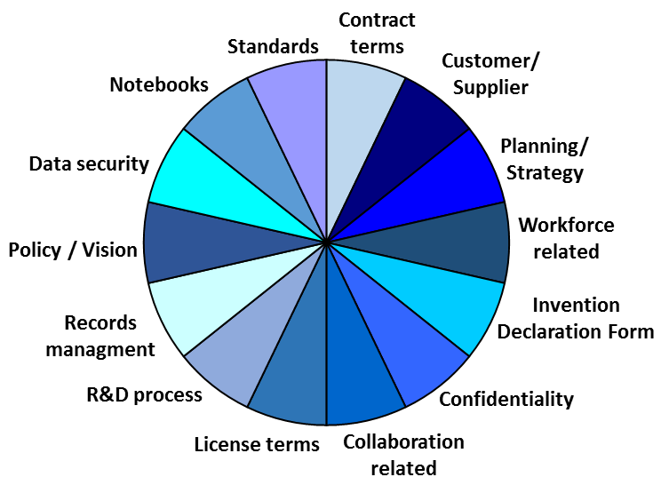
Intellectual Asset Management
Vision and Management of Creativity
Stated intent
Data management
Confidentiality
IP terms
Document templates
Processes to ring fence creativity
Intellectual Asset Management
Processes

Slide 8
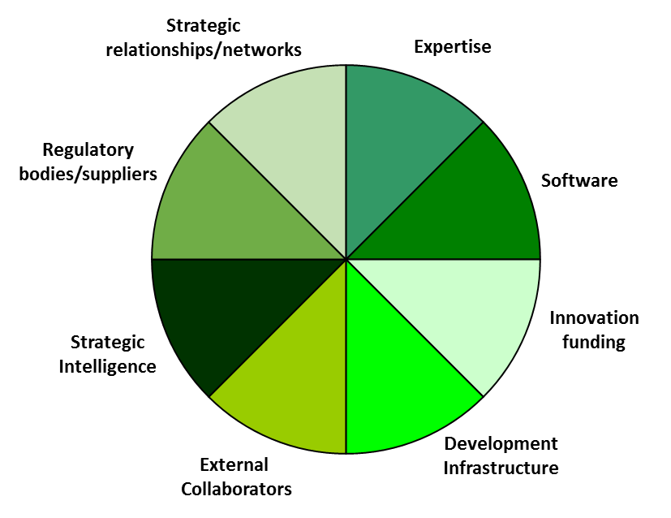
Intellectual Asset Management
Resources and Capability to Innovate
Internal talent
Innovation financing
Partners/Collaborators
Development facilities
Innovative potential
Networks
Intellectual Capital
Intellectual Asset Management
Processes

Slide 9
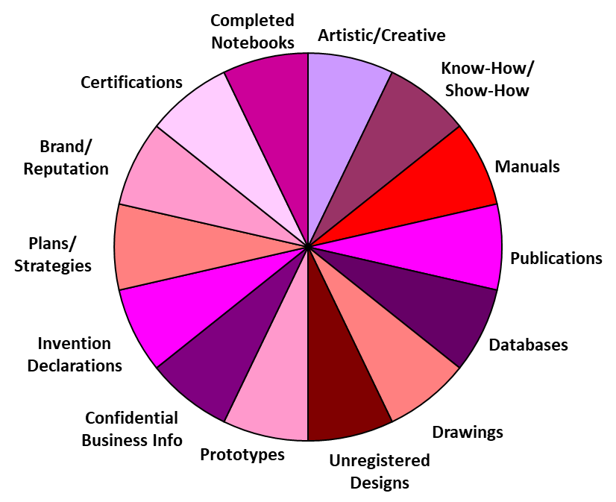
Intellectual Asset Management
All Creativity Related Output
Intangible value/USPs
Accumulated Data
Executed agreements
Confidential information
Foundation for IP
R&D Documents and Records
Intellectual Assets
Intellectual Capital
Intellectual Asset Management
Processes

Slide 10
Intellectual Asset Management
Core Intellectual Assets
A subset of IAs
Key sources of intangible value
Recognised legal rights
Enforceable, Valuable & Transferable Creativity
Intellectual
Property
Intellectual Assets
Intellectual Capital
Intellectual Asset Management
Processes

Slide 11
Communicating your Value
Example: Supporting a patent enforcement action or investor due diligence
Patent
The Asset
Data & Records
Technical data, notebooks, undisclosed info, IP pipeline, licenses, agreements, assignments, certifications etc.
Resources
Funding, inventors, intelligence, collaborators, precursors etc.
Process
IAM system, invention capture process, contract terms, policies, reward and recognition, standards etc

Slide 12
IP Strategy –
Using Intellectual Assets to Scale Innovative Businesses

Slide 13
IP Strategy and Scalability
Intellectual Asset
Management
+
Business Development Strategy
=
IP led Scaling
4. Scaling, investment and exploring new value creation opportunities. Keeping competitors out!
Intellectual
Property
Value Multiplication &
Profit Maximisation
Intellectual Assets
3. Capturing demand to drive market led innovation. Sources of competitive advantage. Attracting customers in!
Market Development
Intellectual Capital
Innovation
Activities
2. R&D, innovation, technology development, NPD, collaboration, artistic/creative, brand development.
Intellectual Asset Management
Processes
Management &
Leadership
1. Establishing and leading the vision. Processes to ring fence the creative potential of the business. Security, terms and documentation.

